Slide 1
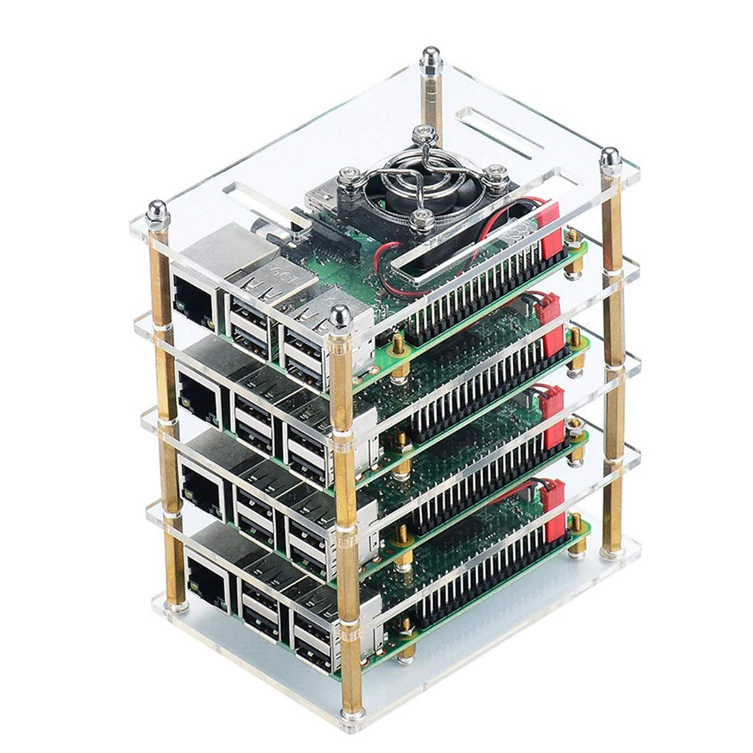
DataLogger – PoC
I have some Raspberry Pis, wouldn‘t it be really cool to use them to learn abit about some concepts like IoT, Docker, Kubernetes, DevOps?
Agenda:
IoT Concept / Architecture
PoC Data Logger Intro
Environment Preparation
Docker
Kubernetes
Development Pipeline

Slide 2
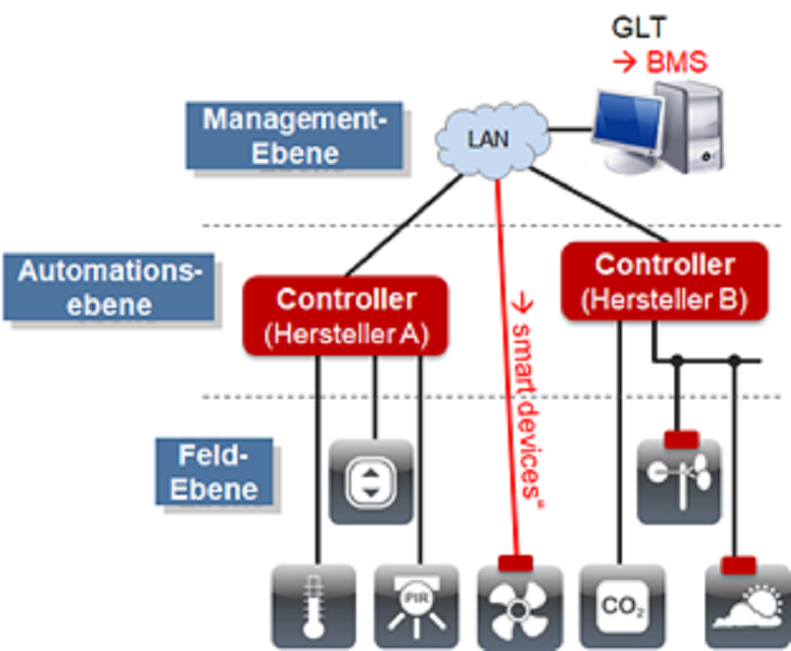
Example: BMS
Source: https://www.enwipo.de/2018/04/03/checkliste-fuer-building-management-systems/

Slide 3
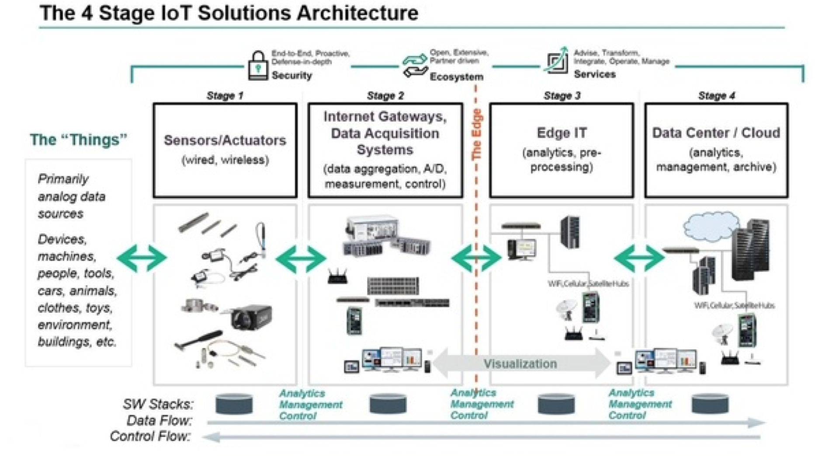
IoT stages
Source: https://medium.com/datadriveninvestor/4-stages-of-iot-architecture-explained-in-simple-words-b2ea8b4f777f

Slide 4
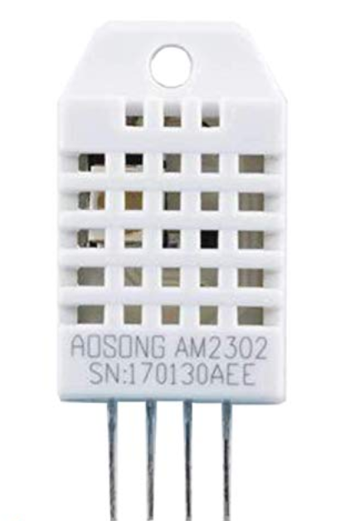
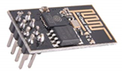
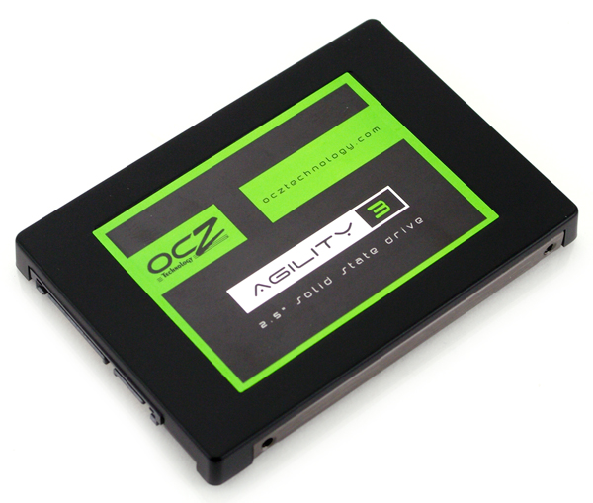
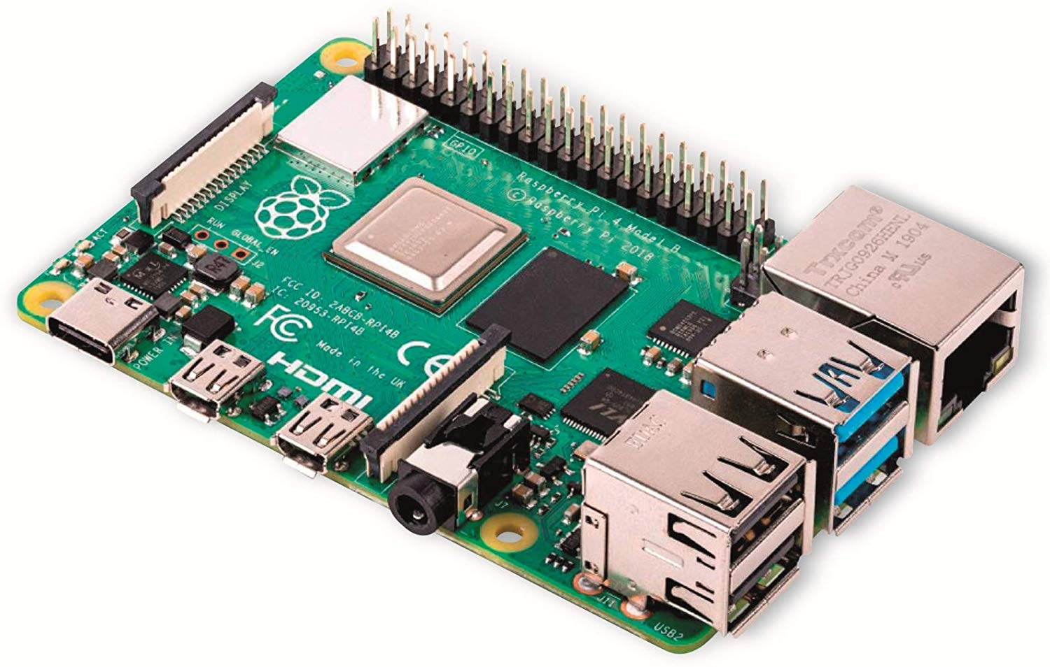
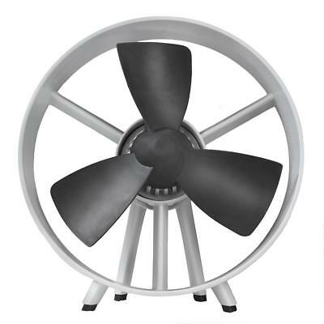
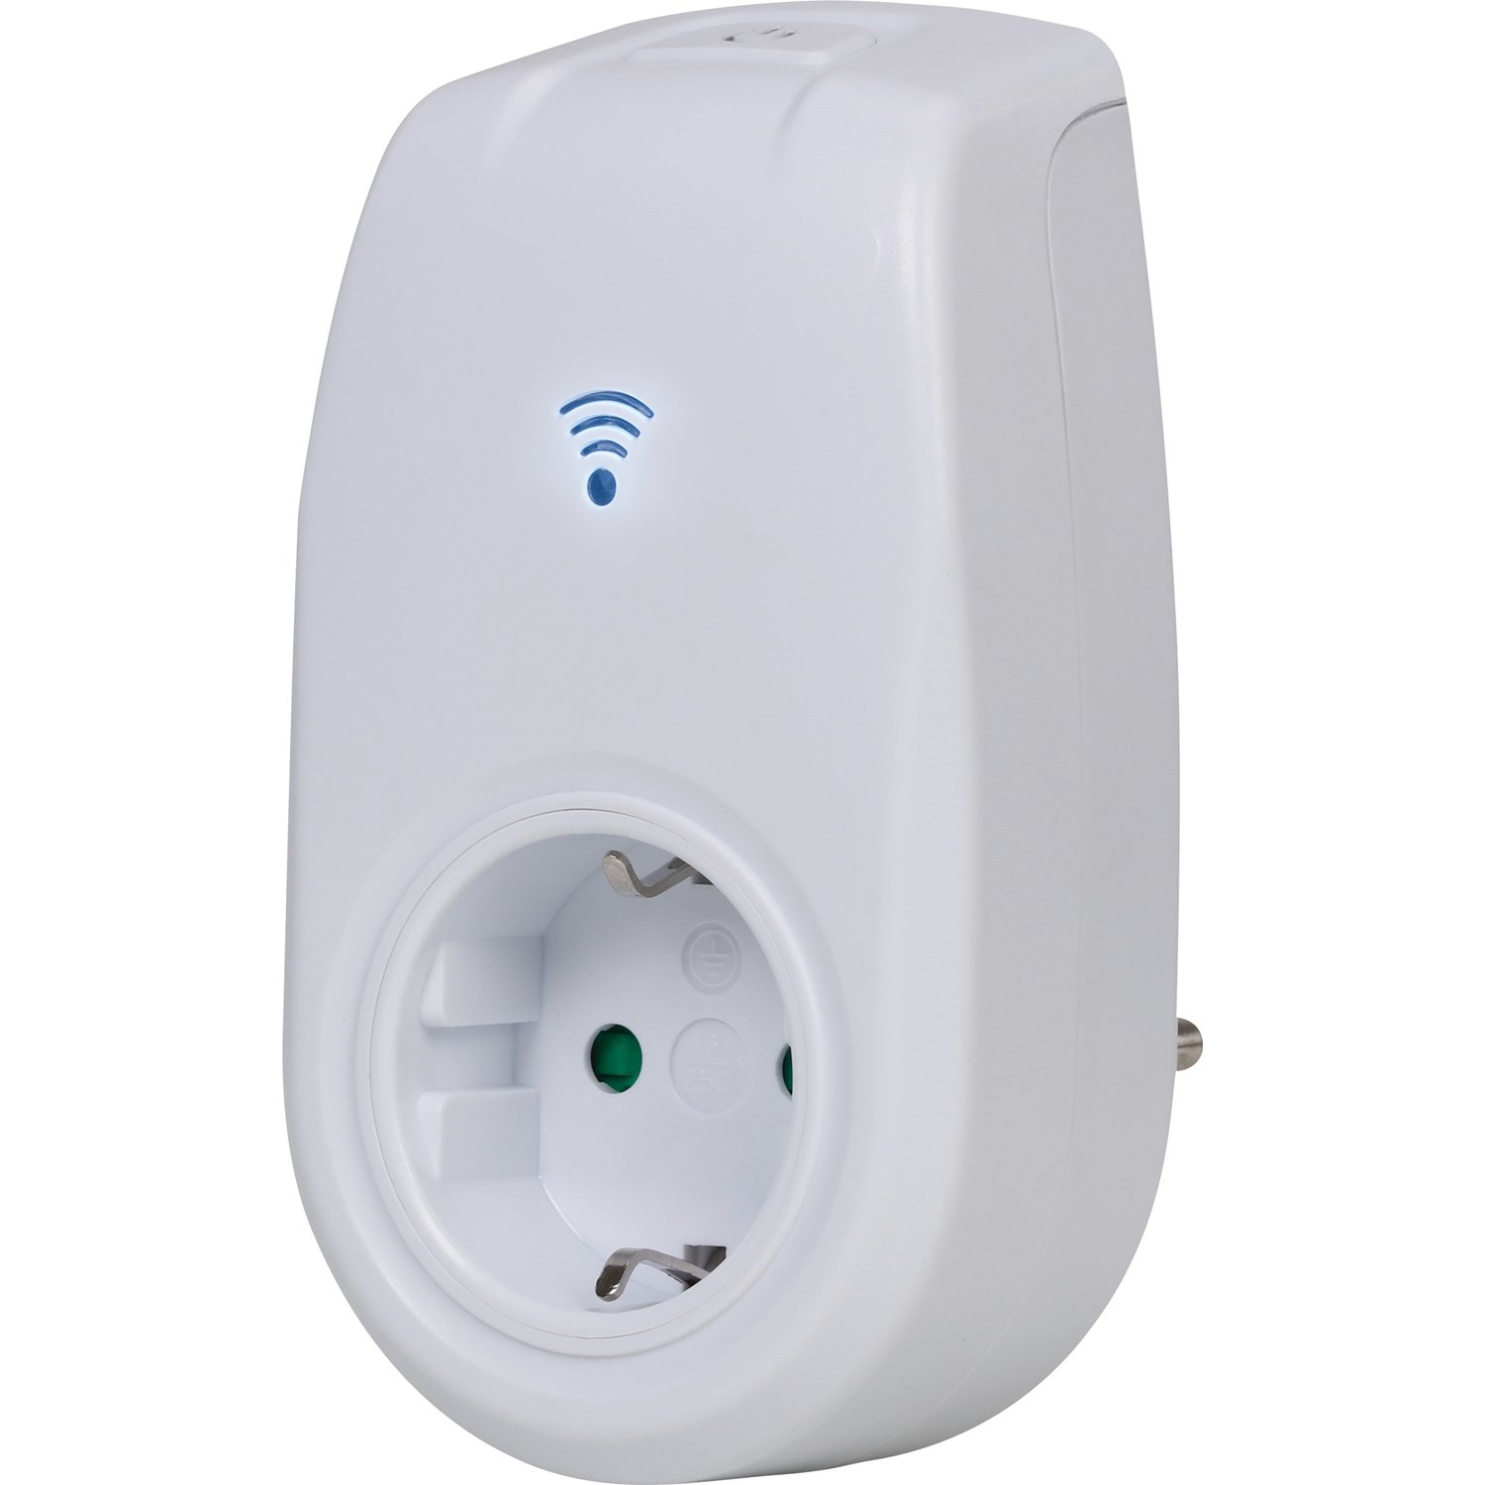
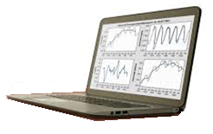
Overview PoC
Controller
Sensors/Actors
Edge-IT

Slide 5
Info Flow
HTTP-REST
1
2
HTTP-REST
MQTT
3
4
5
Monitoring
Analytics

Slide 6
CI/CD Flow
Building/Integrate/Test
Packaging
Deploying
Run

Slide 7
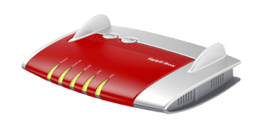
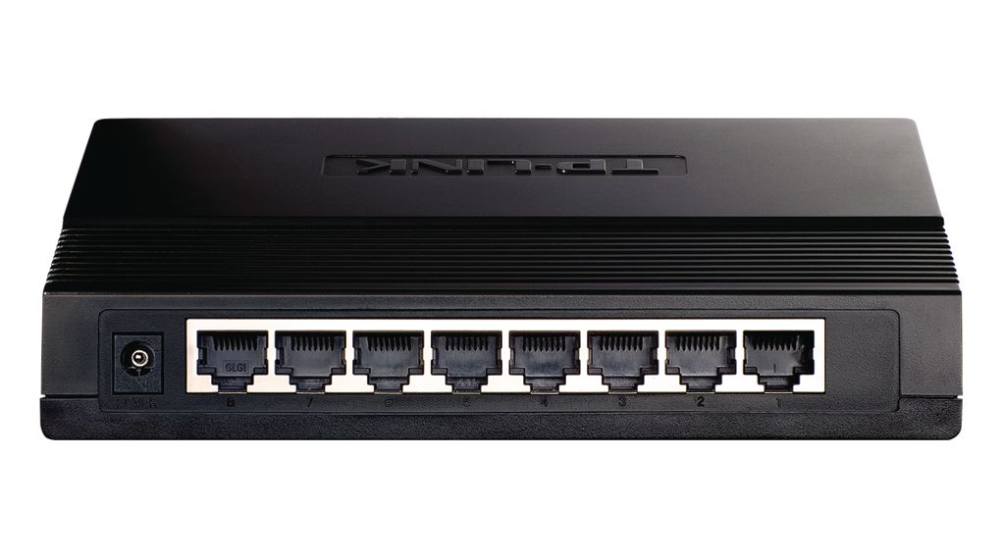
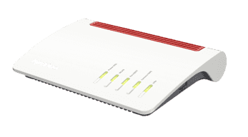
Preparing the Environment - Networks
Cluster-Net
Logger-Net
Home-Net
Internet

Slide 8
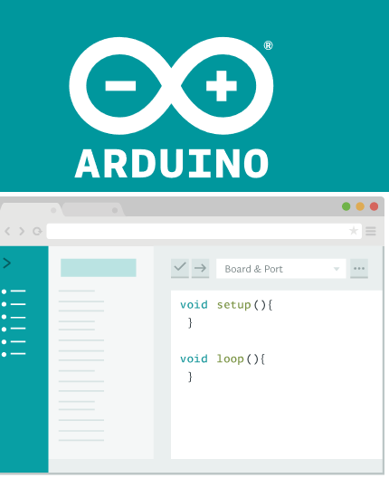
Sensors and Actors
Sensor DHT22
IC: ESP8266-01
Sonoff-Tasmota
1
3
assembling
flashing
3
flashing
OBI WiFi
IC: ESP8266-01
2
develop
compile
temperature.ino

Slide 9
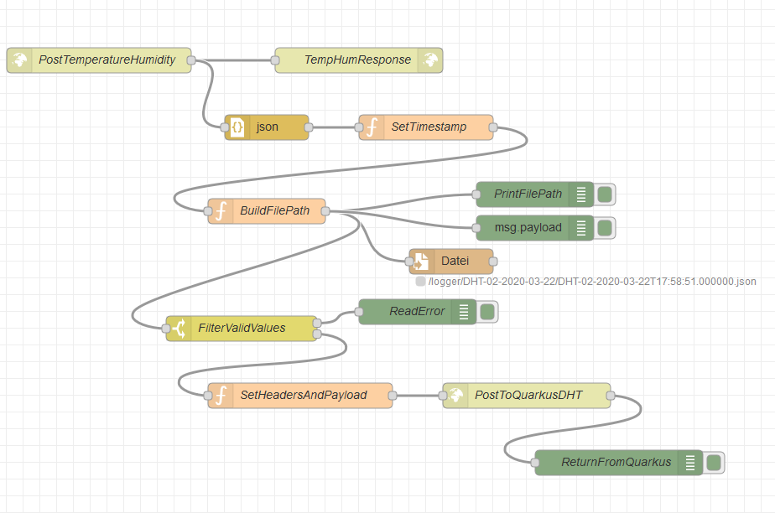

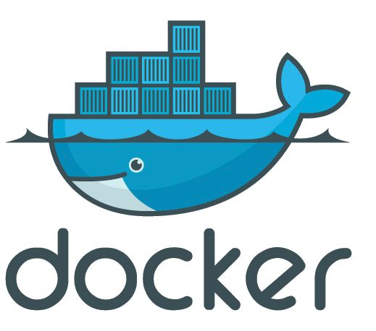
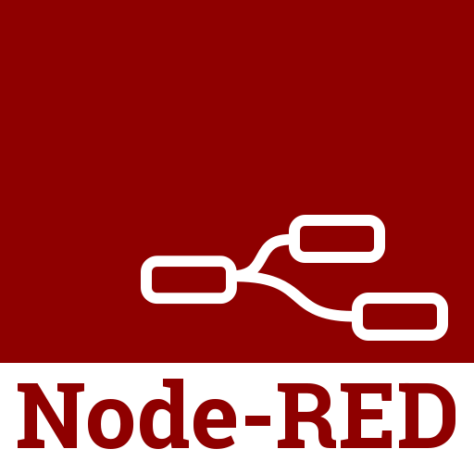
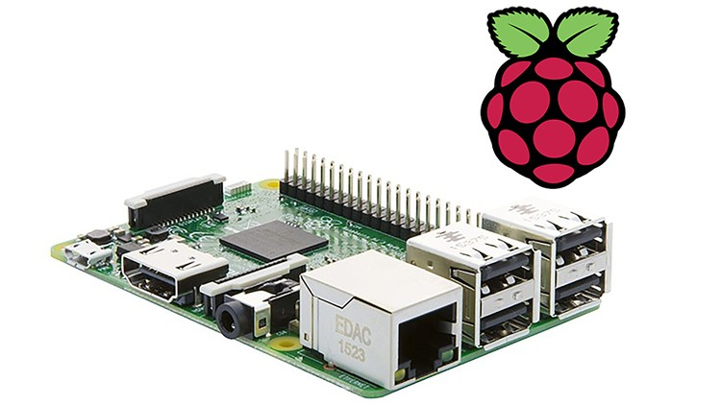

Logger Controller
SSD-Drive
Container:
Node Red
Raspberry Pi 3 Ubuntu Arm64
(alternatively: Bananapi Armbian AArch64)
Container:
Mosquitto

Slide 10

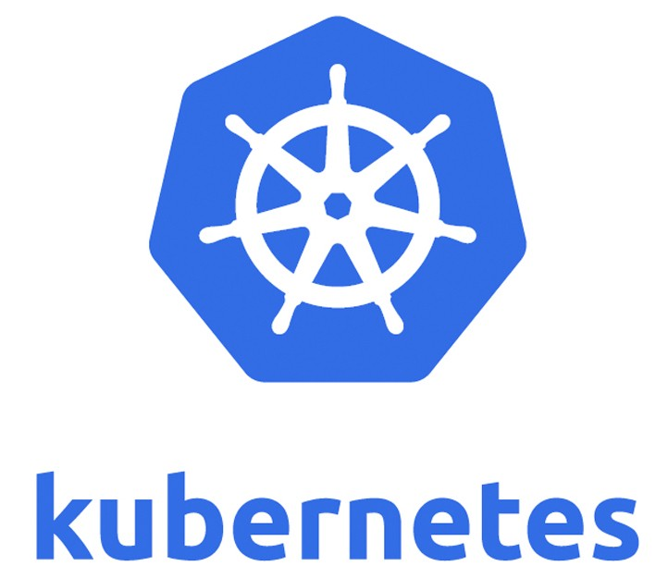


Raspi Cluster
Different Pods
3 Kubernetes Nodes
Raspberry Pi 4 Ubuntu Arm64
Raspberry Pi 3 Ubuntu Arm64
SSD-Drive
Expose as NFS
Raspberry Pi 3 Ubuntu Arm64
Docker Containers:
MariaDB
Prometheus
Grafana
Raspberry Pi 4 Ubuntu Arm64

Slide 11
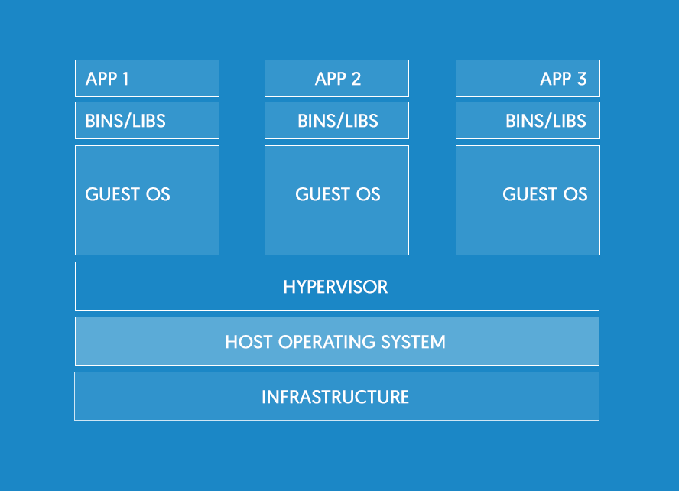
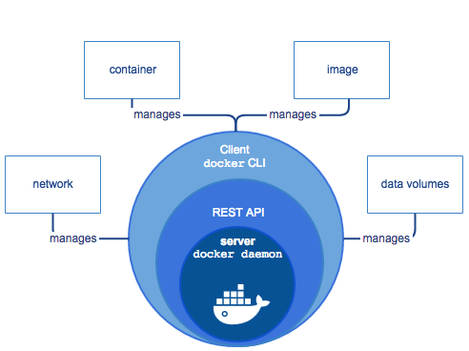
Some Basics - Docker
From Image Registry
e.g.
Dockerhub
Runtime
Source: https://jaxenter.de/einfuehrung-docker-tutorial-container-61528

Slide 12
Some Basics - Docker
################################################################################
# Node-RED Stack or Compose
################################################################################
# docker stack deploy node-red --compose-file docker-compose-node-red.yml
# docker-compose -f docker-compose-node-red.yml -p myNoderedProject up
################################################################################
version: "3.3"
services:
node-red:
image: nodered/node-red:latest
environment:
- TZ=Europe/Berlin
ports:
- "1880:1880"
networks:
- node-red-net
volumes:
- /mnt/extssd/nfs/nodered/data:/data
networks:
node-red-net:
From Docker Hub
Expose IP-ports to host
‚mount‘ volumes from host

Slide 13
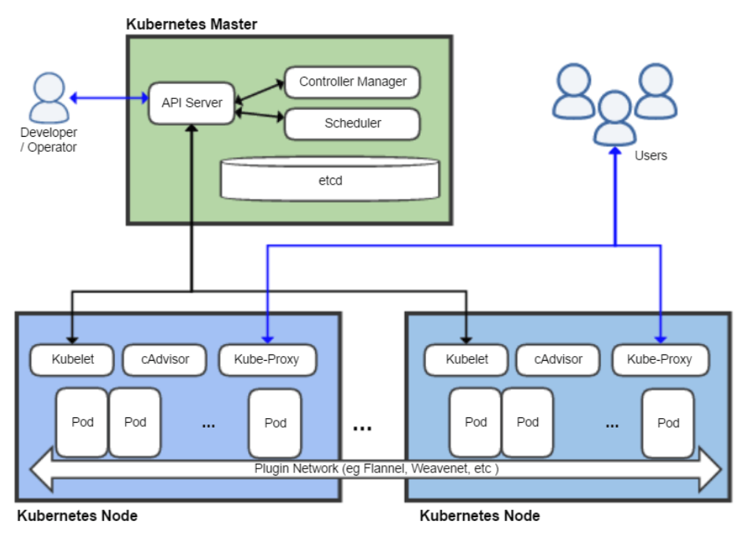
Some Basics - Kubernetes
From Docker Image Registry
e.g.
Dockerhub
Pods ~ Container
Source: https://www.informatik-aktuell.de/entwicklung/methoden/kubernetes-architektur-und-einsatz-einfuehrung-mit-beispielen.html

Slide 14
Some Basics - Kubernetes
Logger Deployment
apiVersion: apps/v1 # for versions before 1.9.0 use apps/v1beta2
kind: Deployment
metadata:
name: logger-server
labels:
app: logger-server
spec:
selector:
matchLabels:
app: logger-server
replicas: 3 # tells deployment to run 3 pods matching the template
template:
metadata:
labels:
app: logger-server
version: v2
spec:
containers:
- name: logger-server
image: hdwinkel/logger-server-jvm-arm64:v2
env:
- name: QUARKUS_DATASOURCE_URL
value: "jdbc:mysql://192.168.188.40:3306/logger"
ports:
- containerPort: 8080
Logger Service
apiVersion: v1
kind: Service
metadata:
name: logger-server
spec:
selector:
app: logger-server
ports:
- protocol: TCP
port: 8080
targetPort: 8080
type: NodePort
Number of Replicas
From Docker Hub
Expose IP-ports

Slide 15

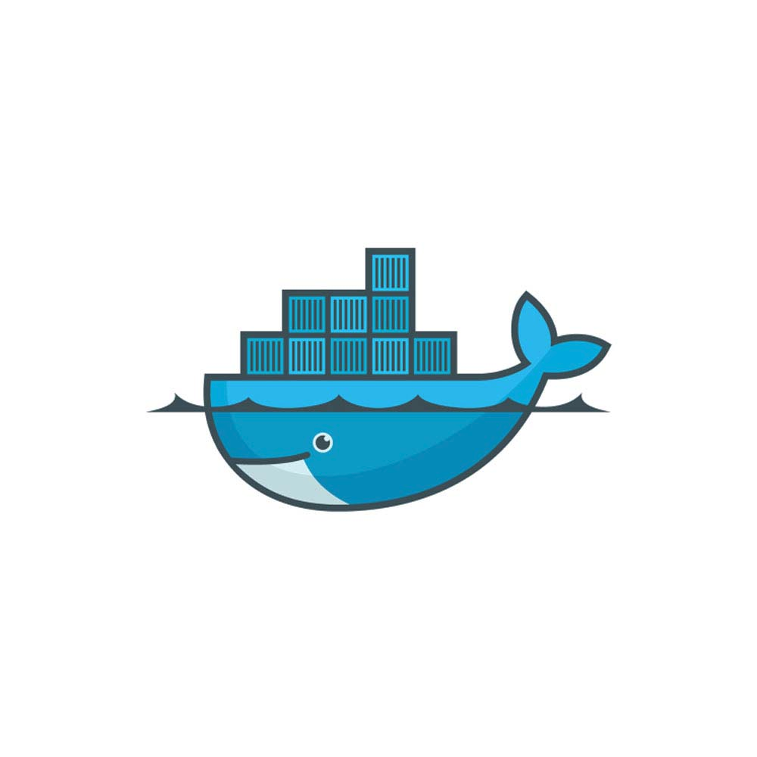
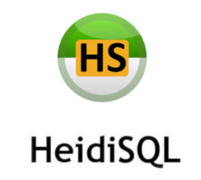


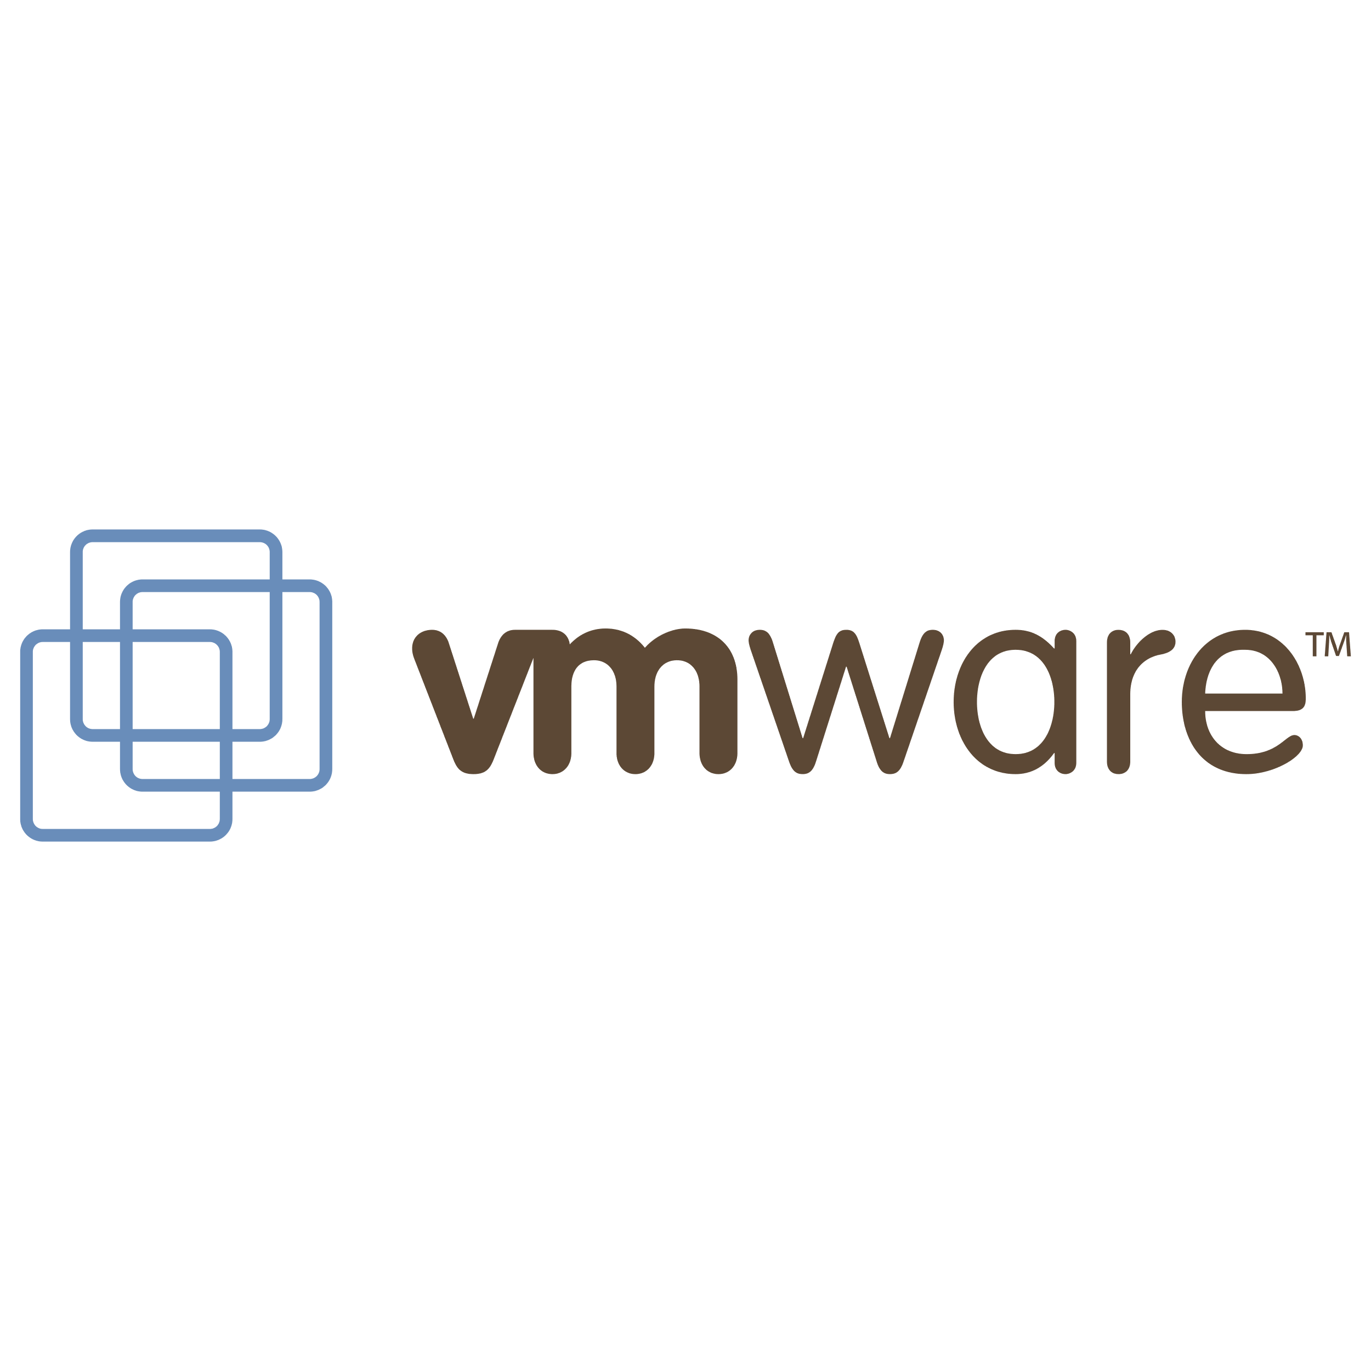








Development
Challenges:
Hardware limitations (Raspi 3 has a memory limit of 1G, too less for build process)
Cross platform architecture (AMD64 vs. Arm64)
Complex deployment chain (GitHub, DockerHub, ..)
Complex Network Setup
Microservices configuration
Visual Studio Code
Docker Hub
GitHub

Slide 16
Development – Software Stack
GitHub
Docker Hub
Kubernetes Master
Docker
Raspberry 3/4 Ubuntu 19.1 (Arm64)
Quarkus App
Source
Quarkus App
Pod
4
Quarkus App
(1) Development
VSC in VMWare
and publish to GIT
2
(2) Package
App and build
Docker
Image
(3) Publish
Docker
Image
1
1
3
Kubernetes Slaves
4
2
Raspberry 3/4 Ubuntu 19.1 (Arm64)
(4) Deploy
Kubernetes
with Image
Standard Notebook (Win 10)
Pod
Quarkus App
Ubuntu 18.04
AMD64
VMWare Xubuntu 19.1 (AMD64)
Jenkins
Master
QEMU Ubuntu 19.1 (Arm64)
Quarkus App
Source
Quarkus App
Source
Docker
Quarkus App
Docker
Jenkins
Slave
Maria DB
Docker – Database/Prometheus/Grafana
Raspberry 3/4 Ubuntu 19.1 (Arm64)
Docker
Maria DB

Slide 17
Development – (1) Build (on VMWare)
GitHub: https://github.com/hdwinkel/quarkus-logger/tree/develop
Rest call DHT to QEMU-Raspi (Quarkus App):
============================================
POST:
http://192.168.10.107:58080/logger/dht
Request Header:
Content-Type
application/json
Body DHT
{
"Header": { "Timestamp": "2020-02-15T21:40:00.000000", "Device": "DHTL-T"},
"Body": {"temperature":22.50,"humidity":35.20}
}
POST:
http://192.168.10.107:58080/logger/generic
Body Generic
{
"Header": { "Timestamp": "2020-02-16T22:40:00.000000", "Device": "DHTL-T"},
"Body": {"measurement":"temperature", "value":22.50}
}
Visual Studio Code
GitHub
Sample Call Node Red:
curl -X POST -H 'Content-Type: application/json' -i 'http://192.168.10.106:1880/TempHum' --data '{
"Header": { "Timestamp": "2019-12-30T15:53:28.494652", "Device": "DHTL-01"},
"Body": {"temperature":27.50,"humidity":35.70}
}'
# prepare test database on host and compile
export QUARKUS_DATASOURCE_URL='jdbc:mysql://192.168.10.107:3306/logger1'
./mvnw compile quarkus:dev

Slide 18
Development – (2) Package and (3) Publish (on QEMU)
# get source from GitHub
git fetch origin
git checkout -b develop origin/develop
git pull
# prepare test database on host and compile
export QUARKUS_DATASOURCE_URL='jdbc:mysql://192.168.10.107:3306/logger1'
./mvnw compile quarkus:dev
# package the quarkus app
mvn package
# build docker image
docker build -f src/main/docker/Dockerfile.jvm.arm64 -t quarkus/logger-server-jvm .
# run docker image with db on host
docker run -i --rm -e QUARKUS_DATASOURCE_URL='jdbc:mysql://192.168.10.107:3306/logger' -p 8080:8080 quarkus/logger-server-jvm
# re-tagging quarkus image
docker tag quarkus/logger-server-jvm hdwinkel/logger-server-jvm-arm64:v1
# run container with tagged image
docker run -i --rm -e QUARKUS_DATASOURCE_URL='jdbc:mysql://192.168.10.130:3306/logger' -p 8080:8080 hdwinkel/logger-server-jvm-arm64:v1
# docker login and push
docker login
docker push hdwinkel/logger-server-jvm-arm64:v1
GitHub
Docker Hub

Slide 19
Development – (4) Deployment (on Raspi)
https://blog.alexellis.io/test-drive-k3s-on-raspberry-pi/
on server:
---------------------------------------------------
sudo curl -sfL https://get.k3s.io | sh -
# check service:
sudo systemctl status k3s
# get the token for nodes setup
sudo cat /var/lib/rancher/k3s/server/node-token
# test cluster:
K1048944fccc87db030c887205d382f02395acd024f5eea2a98648007f5eb387096::server:be86ace82b7ac0a20a47b0d0816316b3
on nodes:
---------------------------------------------------
# test cluster:
export K3S_URL="https://192.168.188.41:6443"
export K3S_TOKEN="K1048944fccc87db030c887205d382f02395acd024f5eea2a98648007f5eb387096::server:be86ace82b7ac0a20a47b0d0816316b3"
sudo curl -sfL https://get.k3s.io | sh -
on server:
---------------------------------------------------
sudo kubectl get node -o wide

Slide 20
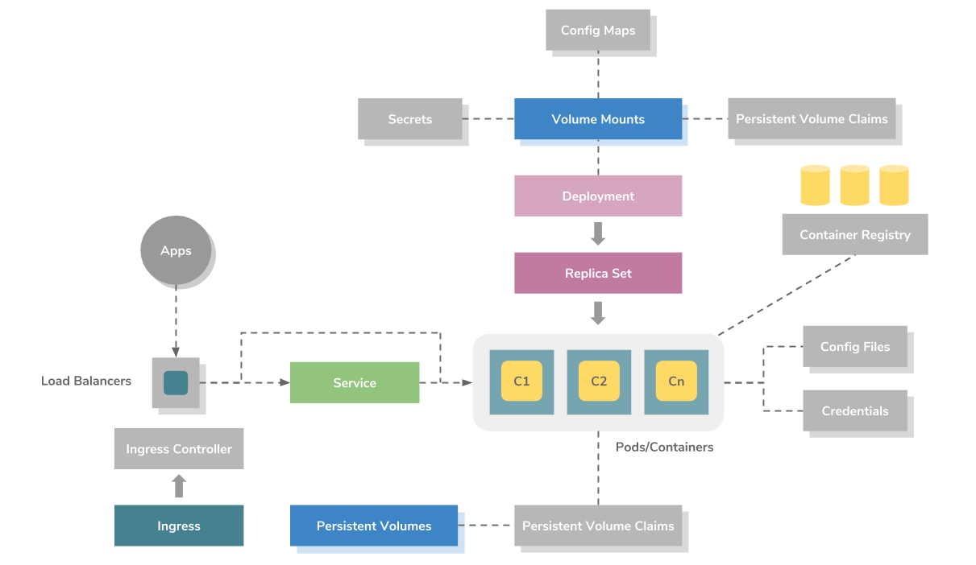
Development – (4) Deployment (on Raspi)
Source: https://medium.com/containermind/a-beginners-guide-to-kubernetes-7e8ca56420b6

Slide 21
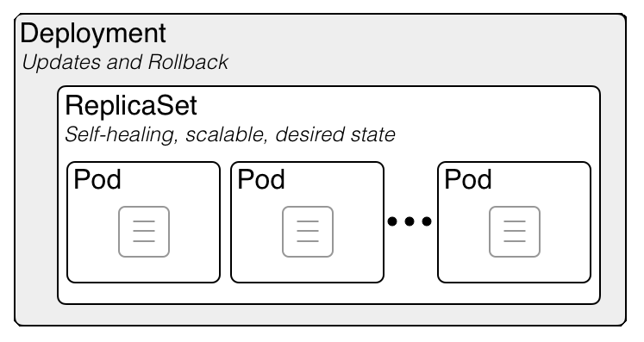
Development – (4) Deployment (on Raspi)
# create the service and deployment
# nano logger-deployment.yaml
# nano logger-service.yaml
sudo k3s kubectl create -f logger-deployment.yaml,logger-service.yaml
# check
sudo k3s kubectl get services
sudo k3s kubectl get deployment logger-server
sudo kubectl get pods -l app=logger-server -o wide
# get deployment info
sudo kubectl get deployments logger-server
sudo kubectl describe deployments logger-server
# get replicaset info
sudo kubectl get replicasets
sudo kubectl describe replicasets
# exposing the service
sudo kubectl expose deployment logger-server --type=LoadBalancer --name=logger-server-jvm-arm64
# check:
sudo kubectl get services logger-server-jvm-arm64
# check the pod status
sudo kubectl get pods -l app=logger–server -o wide
# scale replicaset to 3
sudo kubectl scale --replicas=3 -f logger-deployment.yaml
See as well Deployment Strategies:
https://blog.container-solutions.com/kubernetes-deployment-strategies

Slide 22
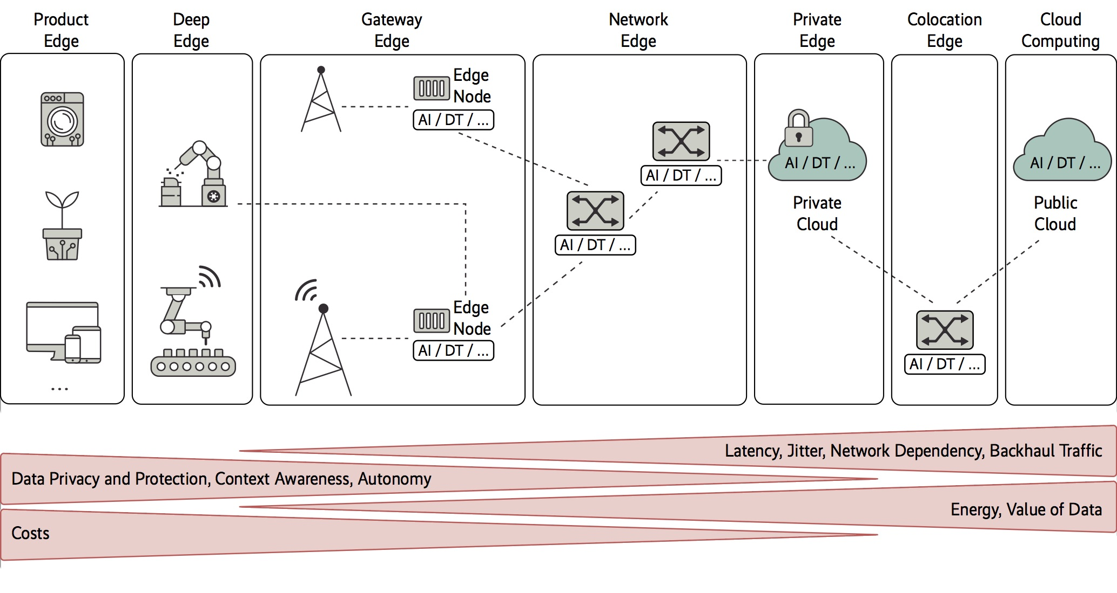
RAMEC 4.0 Levels
Source: https://www.heise.de/select/ix/2019/11/1924712092407948667

Slide 23
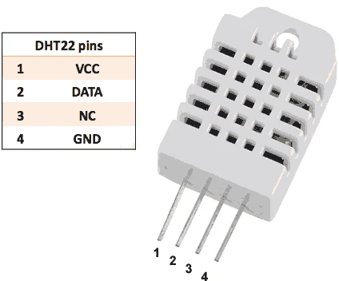
DHT22 - sensor

